Slide 1

DriverPass System Analysis
Anthony Schissler
Notes:
[No speaker notes required for this slide.]

Slide 2

System Requirements
Functional Requirements
The system shall provide a scheduler that matches users with drivers on the specified days, along with car and appointment time
The system shall record user and class scores and make them available for viewing
Non-Functional Requirements
The site should be accessible from all platforms that support modern internet browsing capabilities, which includes mobile devices.
A database will be required to store user testing information, account information, and other reporting requirements such as financial reporting.
Notes:
One of the most important aspects of this business will be our ability to schedule our limited number of drivers and cars with a large amount of potential customers. Doing this work by hand wastes time and energy, and so we will need to create a scheduler that can automatically handle appointment requests between users and drivers, while also ensuring that time conflicts are avoided between appointments. After that bedrock has been established to allow for students and drivers to make appointments, it’s imperative that we work on a system to allow for user scoring to be recorded and made available for viewing. The whole point of this business is to capitalize on students that fail their tests at the DMV – by capturing and showing students the progress they’re making, we’re able to demonstrate the success of our training methodology.
To support our goals, we need to be able to access the widest audience we possibly can. We can accomplish this by making our system and sites available from all devices that support a modern web browser. This also includes mobile devices – and by running through the web and on mobile, we can reach almost anyone. To capture all of the data, training, and financial information that we’ll be working with, we’ll have to setup a database, or a couple. This allows us to store all of our records in a secure space, where we can instantly access our information, and update it as necessary.

Slide 3
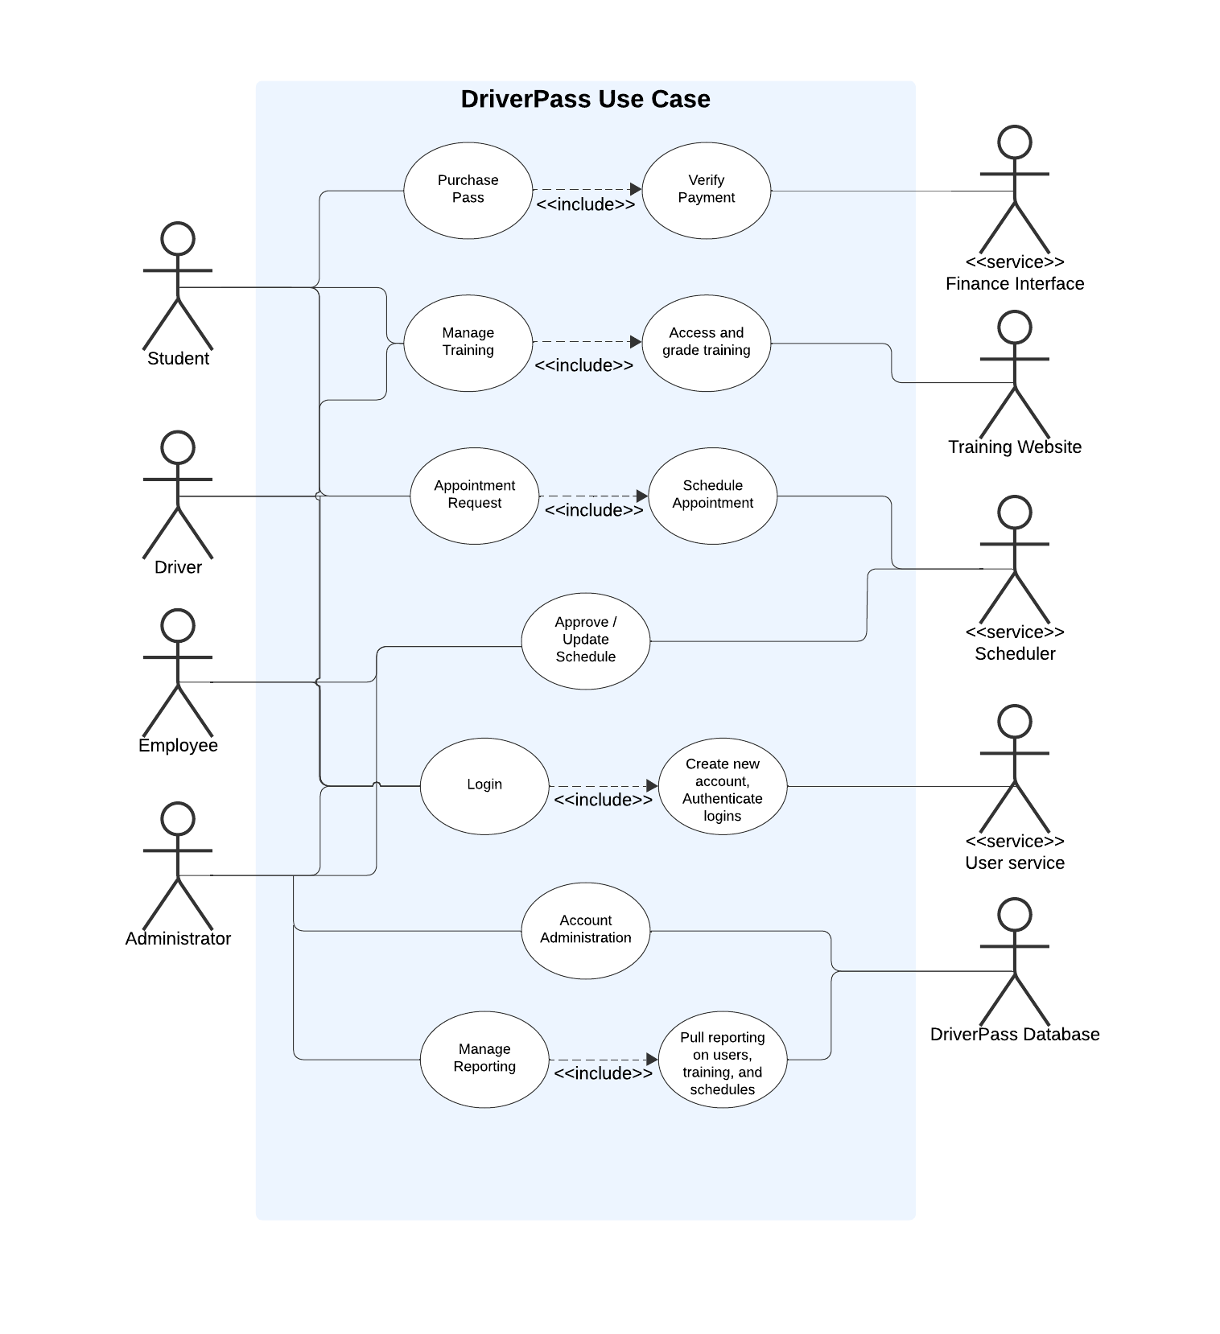
Use Case Diagram
Notes:
We decided to build our system around the 4 potential users of the system, which are mainly our students, our drivers, our employees, and our company administrators. Starting with our students, our first priority is making sure that passes are available for purchases, and that payment is verified before completing the transaction. Our students and our drivers will both need to access training in order to view the student’s progress, give out tests, and give feedback on course material as well. This will be facilitated by our training website. Students and Drivers also need to be able to request and make appointments with each other. For this, we’ll be designing the scheduling feature that I discussed in the last slide, in order to handle appointments with a consistently updated calendar. Our employees and company administrators will also have access to update the schedule as required, and approve appointments for drivers that might be shortly unavailable. All of our users will have to login to our application using a unique username and their chosen password. This will be handled by another service that we will design to handle user logins. For our new students and employees, this will be provided through a self-service website. Finally we’ll be using a database to capture all of the data that will be required to keep the business operational. This includes everything from account information, training data, grades, activity auditing, and financial data as well. Our administrators will have the ability to pull detailed company reports, and also manage the accounts that everyone uses for our appliacation.

Slide 4
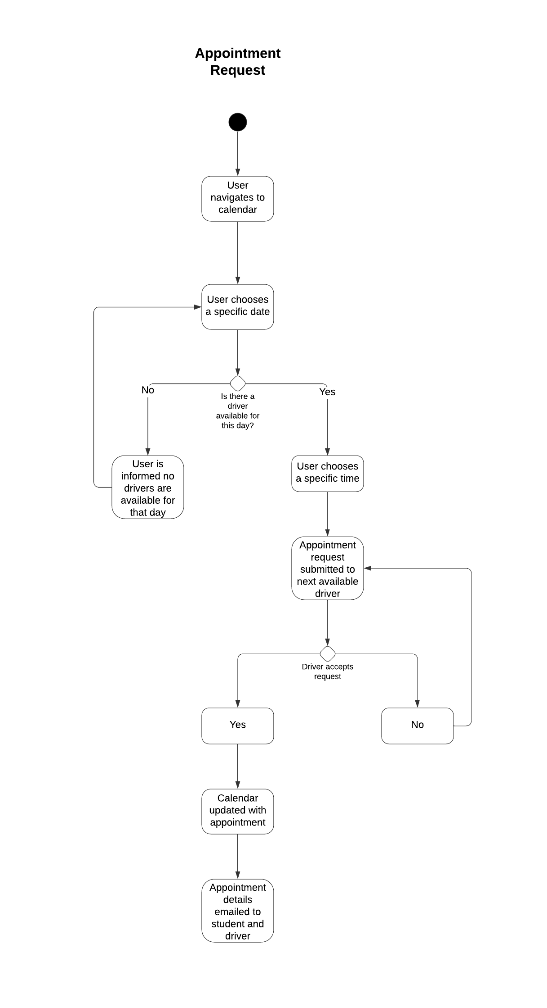
Activity Diagram
Notes:
Here is an example of the work we did on breaking down the actions that users might take, and the different actions that we might have to take based off the user’s action. This example comes from our work on our scheduler, in which a student would like to schedule an appointment day and time with one of our drivers. The student first goes to their calendar on their profile page. Then, the user tries to select the date they’d like to try and have a driver for. The system checks that day, and sees if there’s any openings available that day with any of our drivers. If there aren’t any drivers available, the system informs the student, and the student then picks another date. If we do have drivers available, the student then picks a certain time, and a request is sent off to our next available driver. The driver then confirms the appointment time with the system, and the calendar is updated with the appointment information. In addition, an email is sent out to the driver and the student that the appointment has been confirmed. If the driver rejects the request, it proceeds to the next available driver.
This was created to demonstrate the kind of thinking we need to do in order to ensure our customers have a consistently positive experience. Considering cases where things might not go as planned allows us to build this application to be resilient and reliable, which allows the business to focus more on the business, and less on the technical issues.

Slide 5
Security
All users will create a unique username, which will be followed with a strong password as well as 3 challenge questions
All traffic from our users to our system will be encrypted using the latest version of TLS, ensuring that bad actors aren’t able to easily access transmitted information
Users will have 3 attempts to login to their account. After 3 failed attempts, the account will be locked out, and the user will either have to call the office, or answer their 3 challenge questions to reset their password.
Notes:
Security is something that we all like to complain about when its strict, but praise when it demonstrates that it protects company assets. Making all users have a unique name allows us to quickly and easily determine who is doing what with their access. In addition, adding password complexity and challenge questions prevents these users from having their accounts stolen easily.
One of the easiest ways to steal information on the internet is by stealing data that doesn’t have security protections in place on it while it’s moving from one place to another. Encryption is the way that we manage this problem, as it basically scrambles the data that’s on its way to its destination. If someone tries to steal this data while it’s being moved, they won’t be able to understand what actually was sent. We do this with a security standard called “TLS” which is supported by all modern web browsers, so it will allow us to protect without alienating any potential customers.
Finally we’re giving everyone 3 attempts to login to their account. If those three attempts end up failing, our system will lock the account out, and the user will have to either call the company office to unlock their account, or answer their 3 challenge questions online in order to send a temporary password to their email for a password reset.
Altogether these demonstrate the great strides we’ve made to secure the access that users have on the site, as well as the privileged data that we’ll be using to make this application work.

Slide 6
System Limitations
More time would allow for more robust features
Limited amount of drivers / cars
Cloud can become expensive
Notes:
If we had more time for this project, we would be able to add in more features. The owner of the business wanted to be able to create packages that could be sold to students, but we simple don’t have the time to build a system to accomplish this at the moment. In addition, we only have so many drivers and cars that are available. Users might become frustrated with scheduling appointments if we spread our drivers and cars too thin, so it’s important we always make sure we have the resources we need. Lastly, building this in the cloud can become really expensive if we’re not careful. To make sure we’re on the right track, we’ll have to audit our cloud usage, and make sure that we’re only using the resources that we absolutely need to in order to run the business. Making sure we’re not wasting resources is incredibly important in order to run a successful cloud business.

